Slide 1
Linux Installation
LINUX INSTALLATION

Slide 2
Download LINUX
Linux Installation
To install Red Hat, you will need to download the ISO
images (CD Images) of the installation CD-ROMs
from http://fedora.redhat.com
Download the i386 images for 32 Intel Processors,
PPC images for for Apple Macintosh and x86_64 for
for 64 bit AMD Processors
Burn the iso CD images on CDs and use these CDs
as Installation CDs (typically 4)

Slide 3
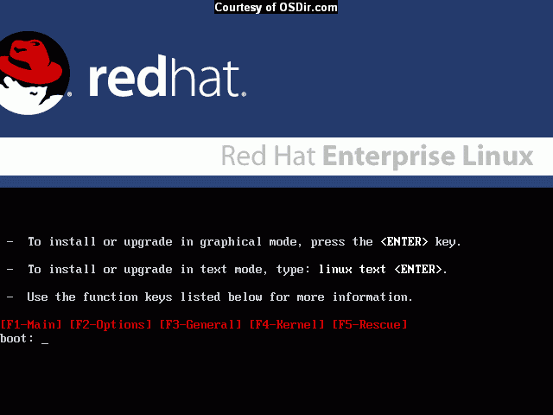

Slide 4
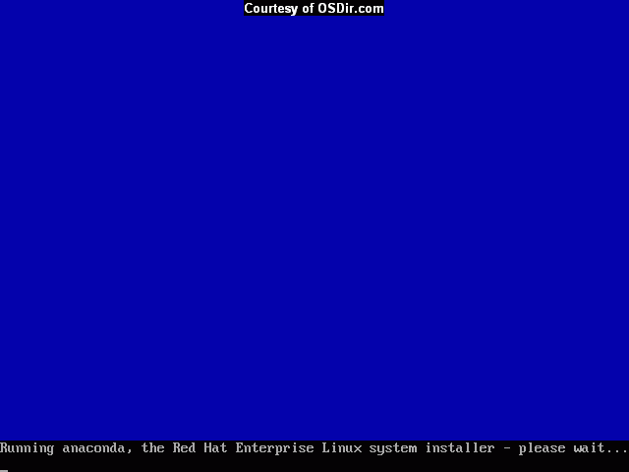

Slide 5
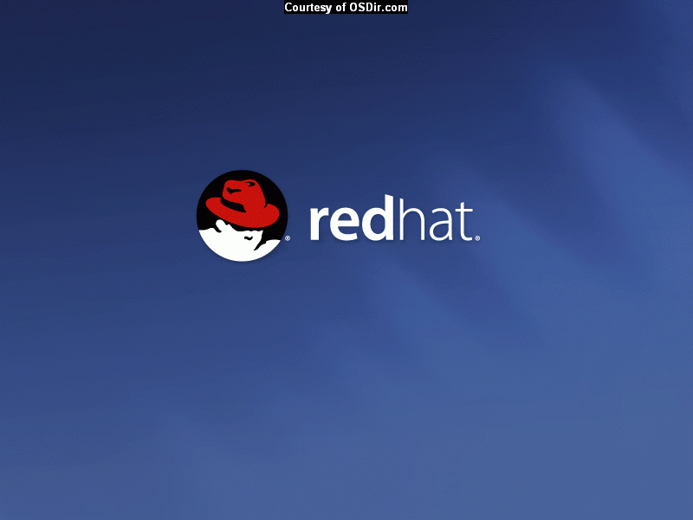

Slide 6
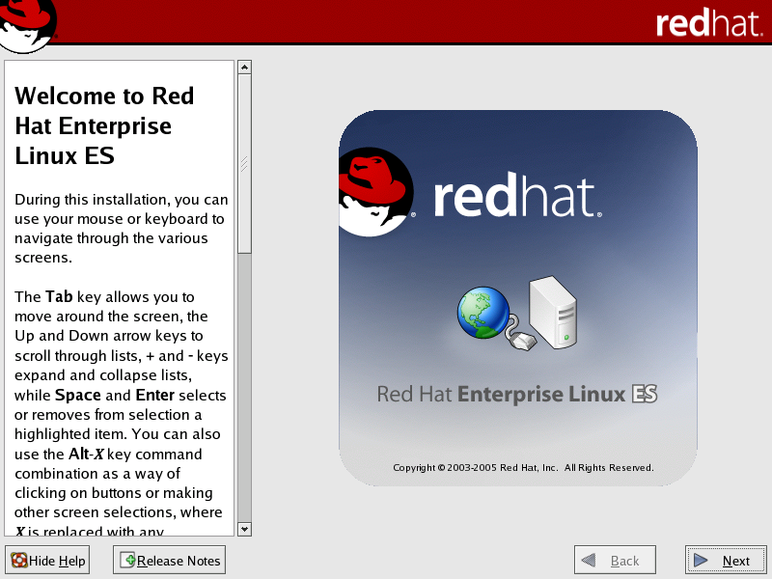

Slide 7
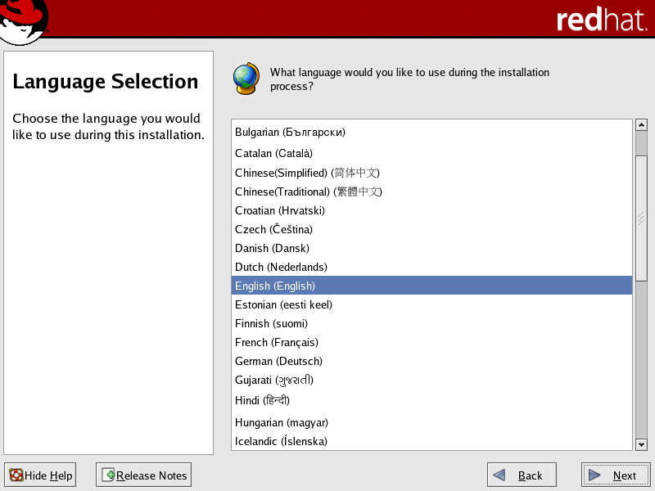

Slide 8
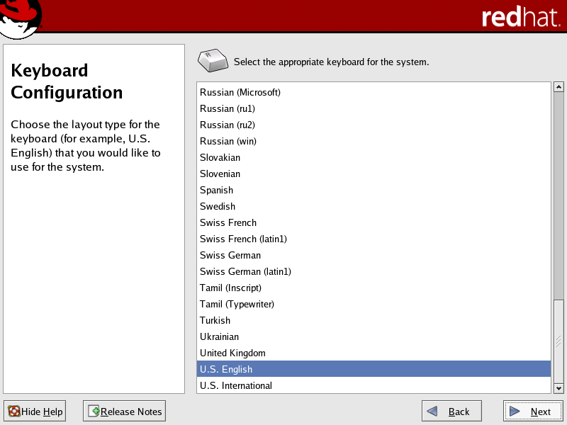

Slide 9
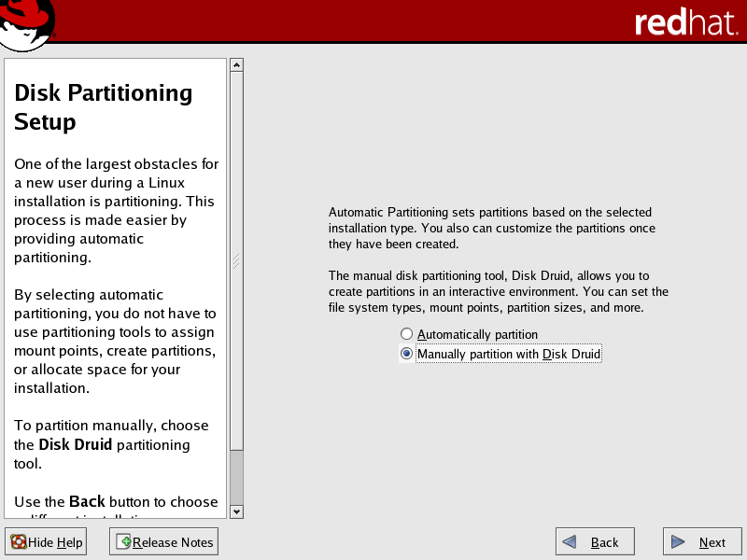

Slide 10
What is a Partition?
Linux Installation
Partitioning is a means to divide a single hard drive into many logical drives.
A partition is a contiguous set of blocks on a drive that are treated as an independent disk.
A partition table is an index that relates sections of the hard drive to partitions.

Slide 11
Why have multiple partitions?
Linux Installation
Reduce the risk of system failure in case a partition becomes full. Runaway processes or maniacal users can consume so much disk space that the operating system no longer has room on the hard drive for its bookkeeping operations. This will lead to disaster. By segregating space, you ensure that things other than the operating system die when allocated disk space is exhausted.
Encapsulate your data. Since file system corruption is local to a partition, you stand to lose only some of your data if an accident occurs.

Slide 12
Partition Fields
Linux Installation
Device: This field displays the partition's device name.
Start: This field shows the sector on your hard drive where the partition begins.
End: This field shows the sector on your hard drive where the partition ends.
Size: This field shows the partition's size (in MB).
Type: This field shows the partition's type (for example, ext2, ext3, or vfat).
Mount Point: A mount point is the location within the directory hierarchy at which a volume exists; the volume is "mounted" at this location. This field indicates where the partition will be mounted.

Slide 13
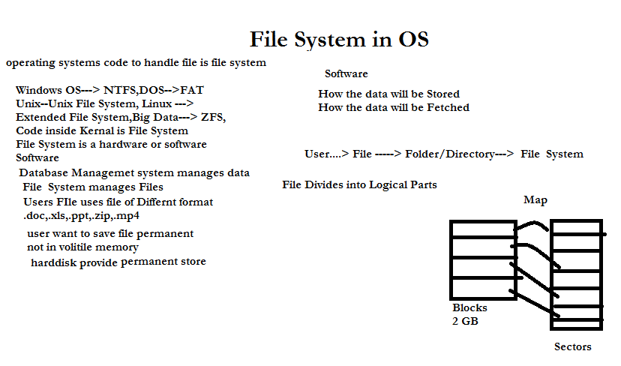

Slide 14
Operations and Attributes
Operations of OS
Creating
Reading
Writing
Deleting
Truncating
Repositioning
File Attributes
Name
Extension
Indetifier
Location
Size
Modified date/ create date
Permision/Protection
Encryption
/Compression

Slide 15
Filesystem Types
Linux Installation
ext2 — An ext2 filesystem supports standard Unix file types (regular files, directories, symbolic links, etc). It provides the ability to assign long file names, up to 255 characters. Versions prior to Red Hat Linux 7.2 used ext2 filesystems by default.
ext3 — The ext3 filesystem is based on the ext2 filesystem and has one main advantage — journaling. Using a journaling filesystem reduces time spent recovering a filesystem after a crash as there is no need to fsck the filesystem.
swap — Swap partitions are used to support virtual memory. In other words, data is written to a swap partition when there is not enough RAM to store the data your system is processing.
vfat — The VFAT filesystem is a Linux filesystem that is compatible with Windows 95/NT long filenames on the FAT filesystem.

Slide 16
Recommended Partitioning Scheme
Linux Installation
Unless you have a reason for doing otherwise, it is recommended that you create the following partitions:
/boot partition – contains kernel images and grub configuration and commands
/ partition
/var partition
/home partition
Any other partition based on application (e.g /usr/local for squid)
swap partition — swap partitions are used to support virtual memory. In other words, data is written to a swap partition when there is not enough RAM to store the data your system is processing. The size of your swap partition should be equal to twice your computer's RAM.

Slide 17
Disk Partition
Linux Installation
IDE(Integrated Drive Electronics) Disk Partitions
  /dev/hda (Primary Master Disk)
    /dev/hda1 (First Primary Partition)
    /dev/hda2 (Second Primary Partition)
  /dev/hdb (Primary Slave Partition)
    /dev/hdb1
  /dev/hdc (Secondary Master/Slave Partition)
    /dev/hdc1
SCSI(Small Computer System Interface) Disk Partitions
  /dev/sda1, /dev/sda2
  /dev/sdb1, /dev/sdb2
  /dev/sdc1, /dev/sdc2

Slide 18
Software RAID and LVM
Linux Installation
Software RAID (Redundant Array of Inexpensive Disk)
  RAID 0 (Striping)
  RAID 1 (Mirroring)
  RAID 5 (Striping with Parity)
LVM (Logical Volume Manager)

Slide 19
Boot Loader
Linux Installation
In order for the BIOS to load an OS it looks for instructions on the first sector of a hard drive.
On the first sector of the hard drive resides the master boot record (MBR), and is where a boot loader is initialized.
Depending on the boot loader, additional files may be stored and read from a partition on the hard drive.
After this step the boot loader begins to start the operating system, and is not used again until the next boot.

Slide 20
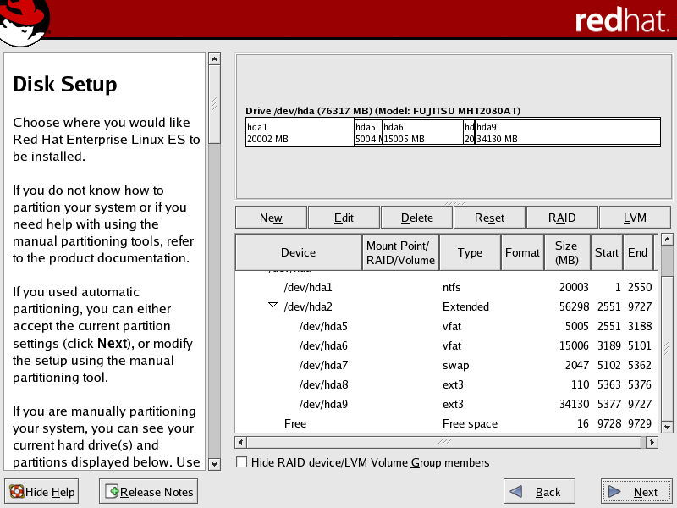

Slide 21
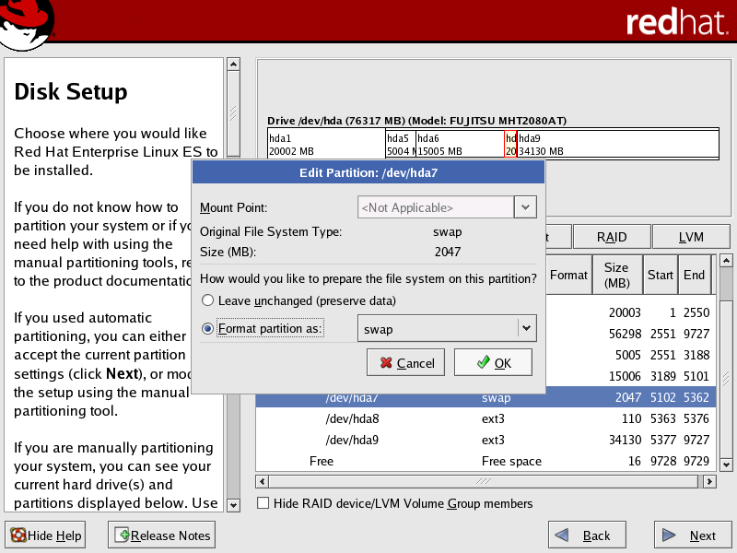

Slide 22
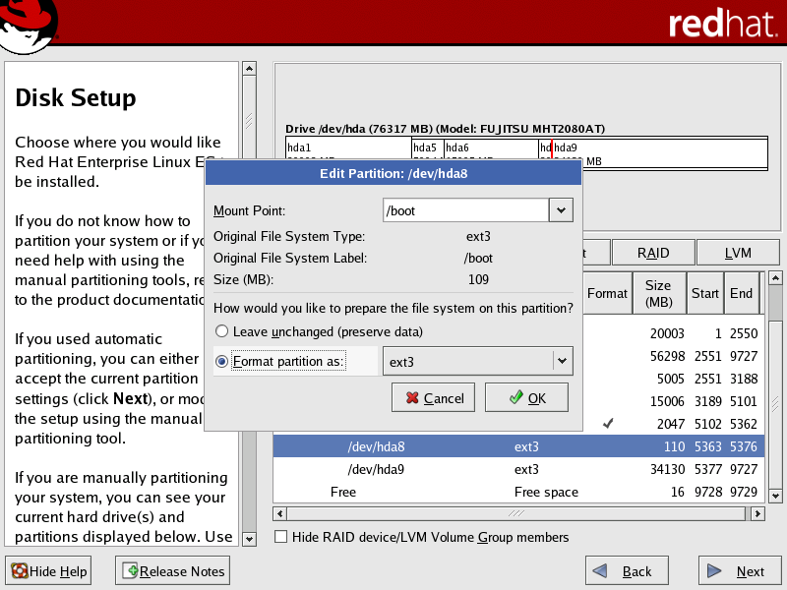

Slide 23
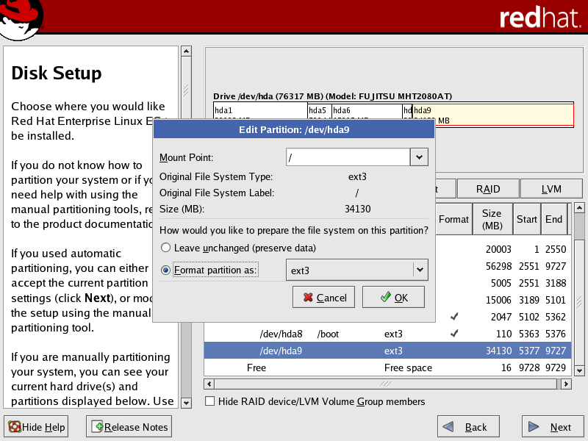

Slide 24
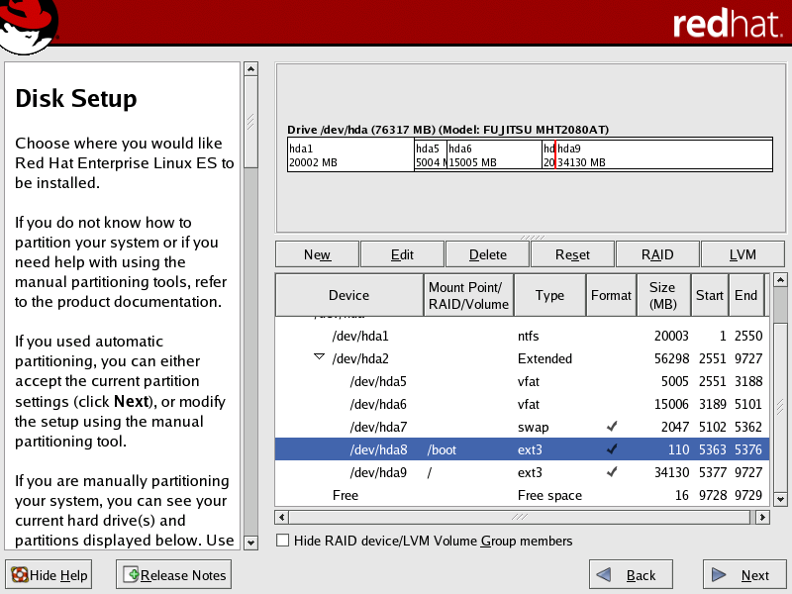

Slide 25
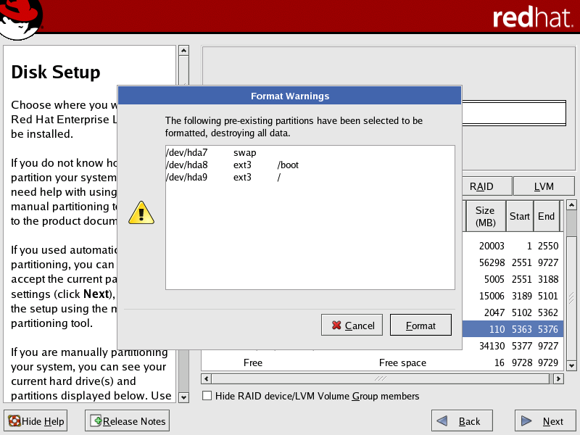

Slide 26
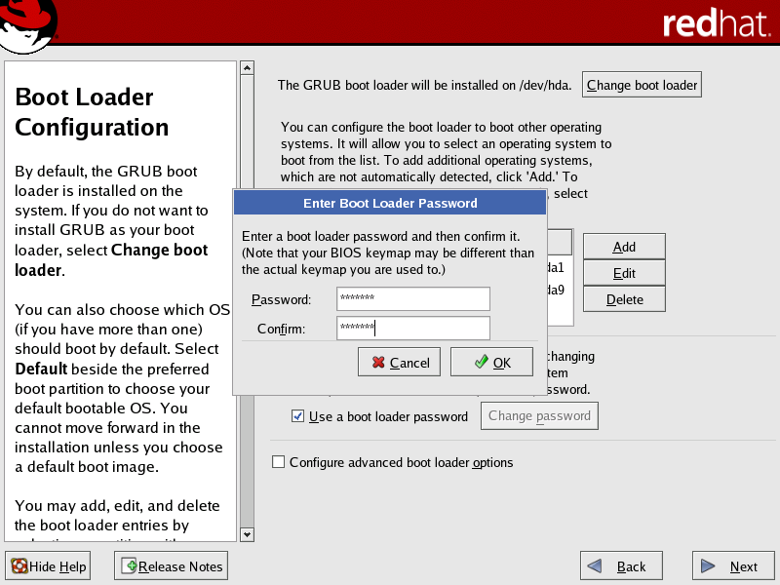

Slide 27
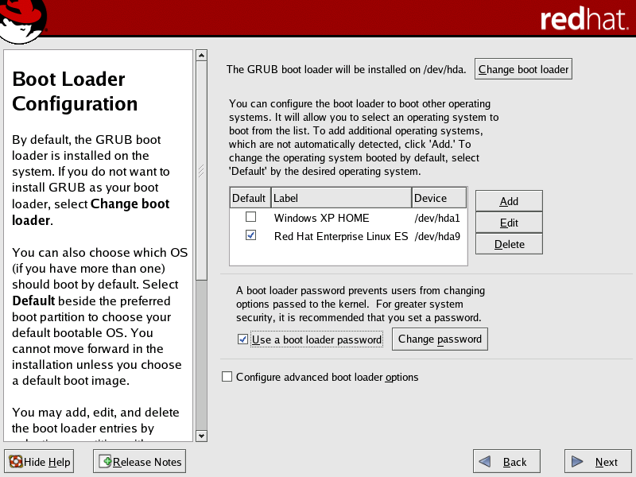

Slide 28
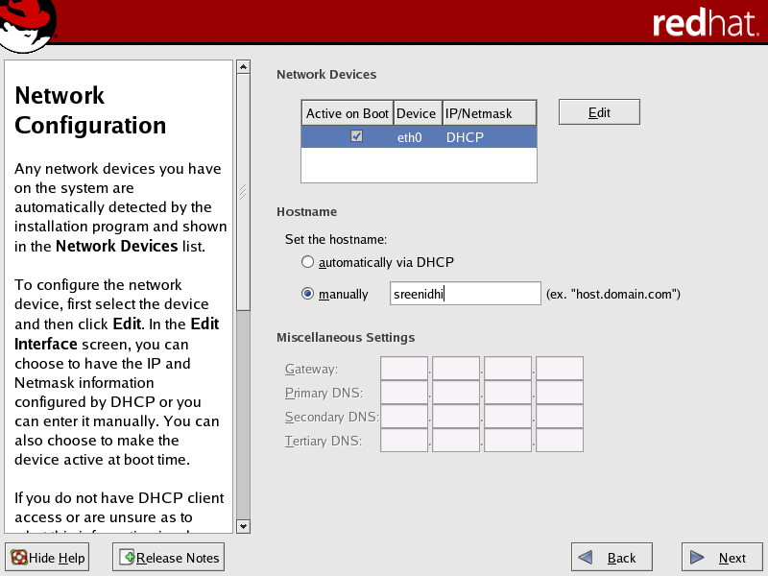

Slide 29
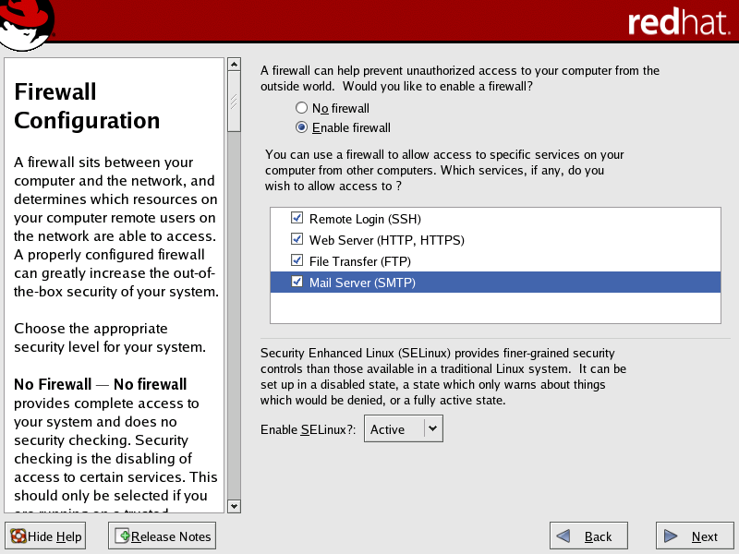

Slide 30
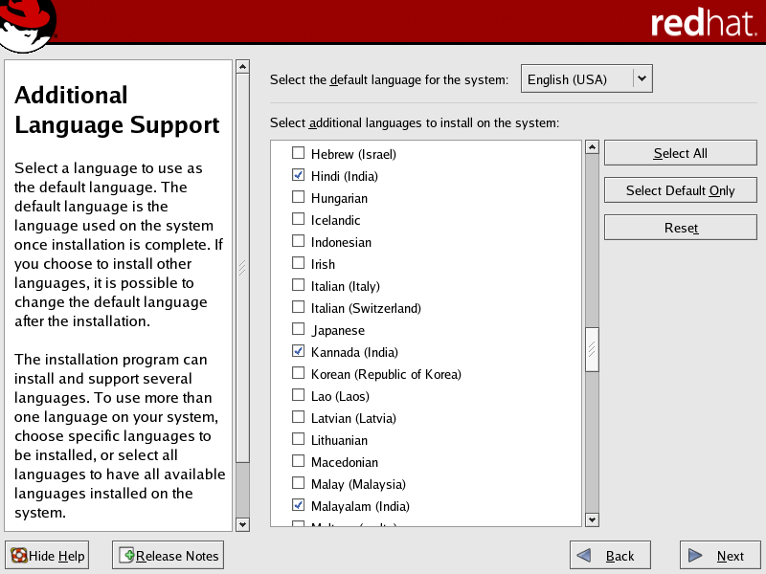

Slide 31
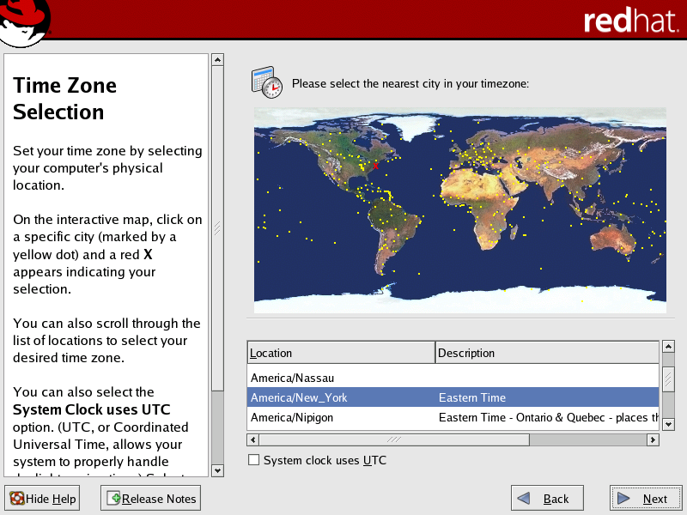

Slide 32
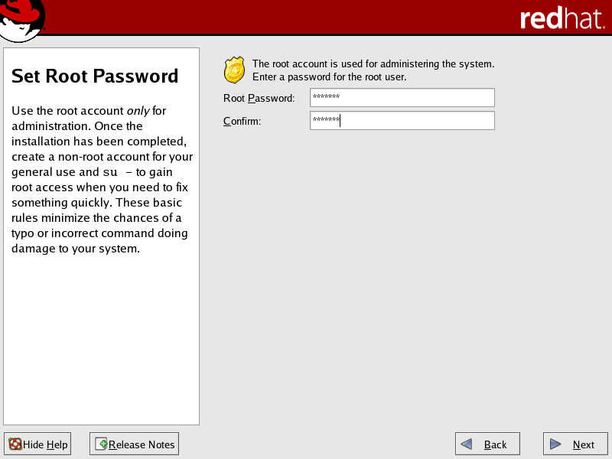

Slide 33
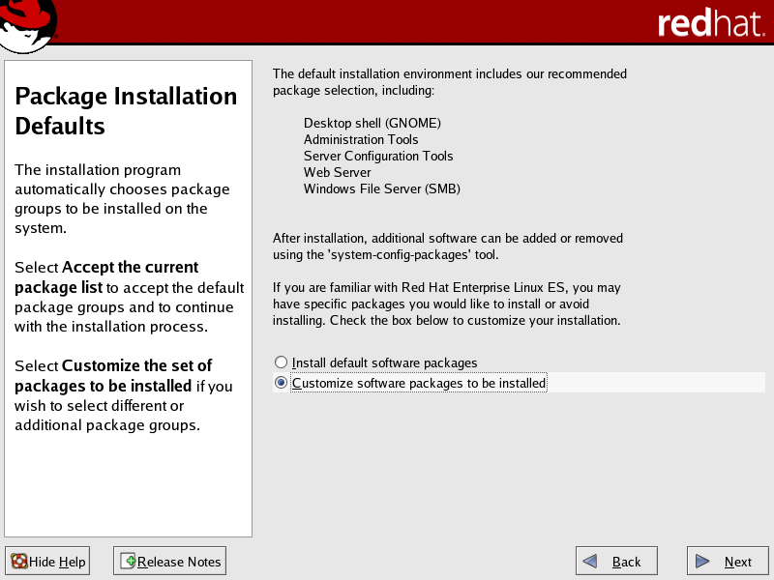

Slide 34
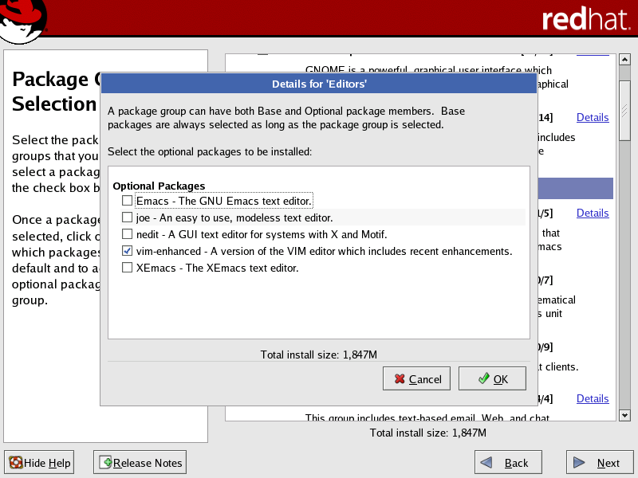

Slide 35
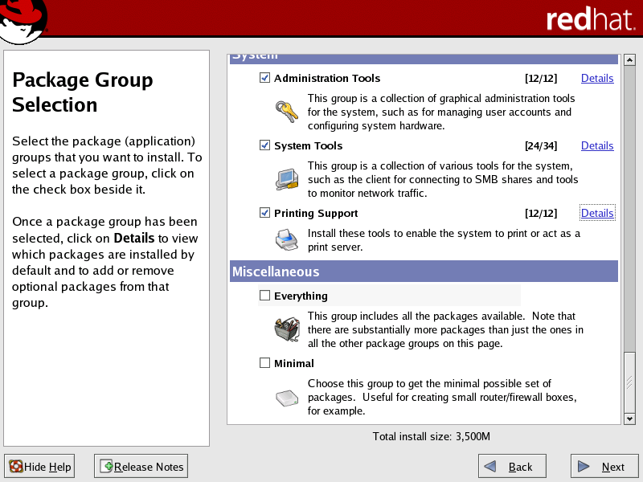

Slide 36
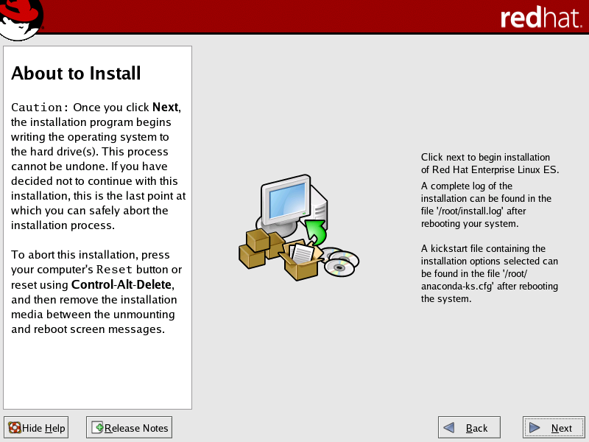

Slide 37
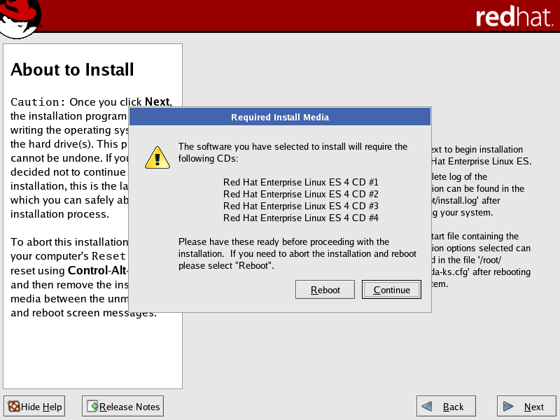

Slide 38
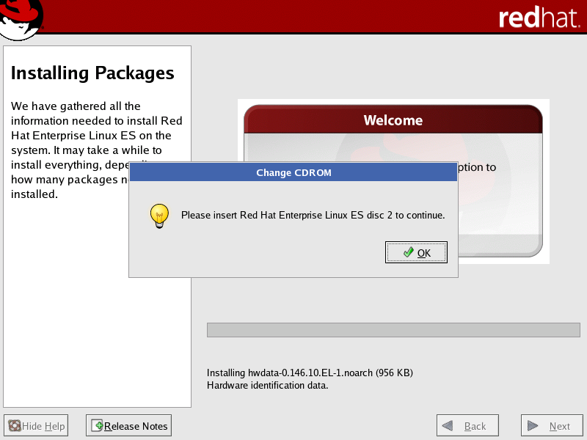

Slide 39
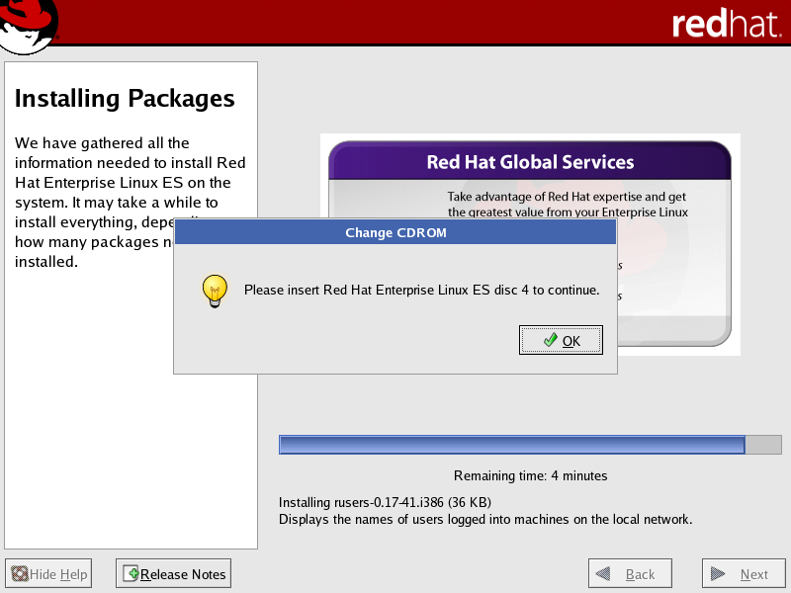

Slide 40
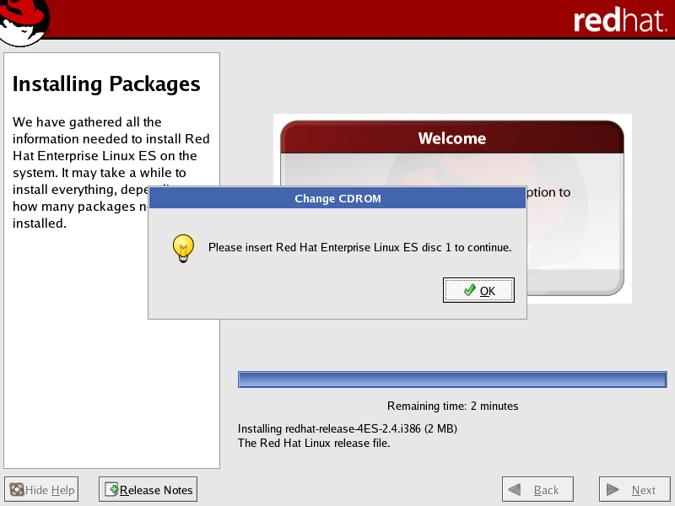

Slide 41
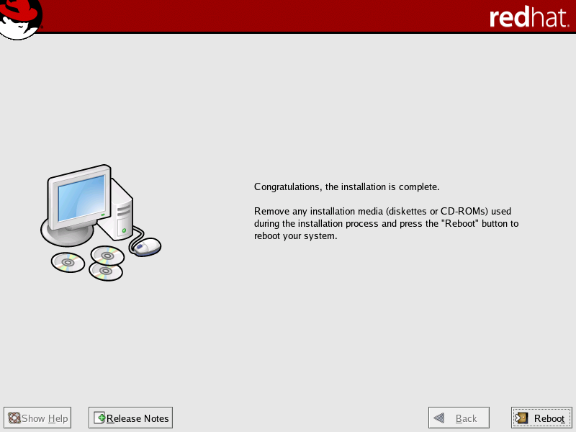

Slide 42
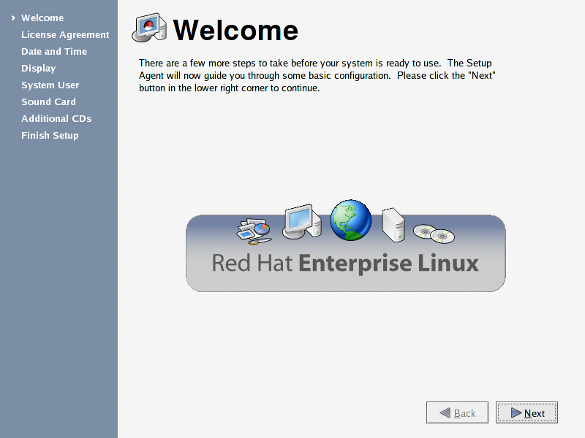

Slide 43
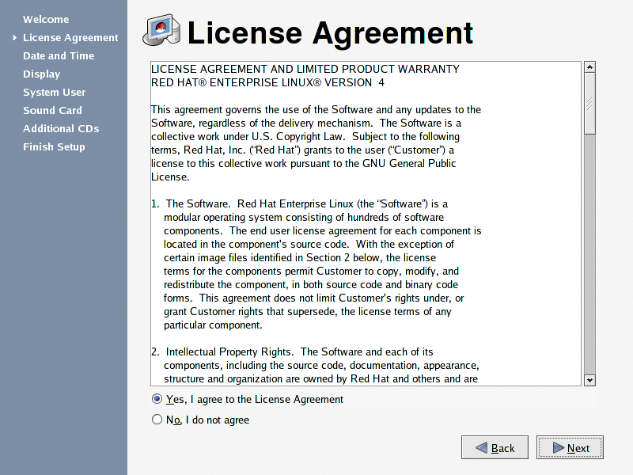

Slide 44
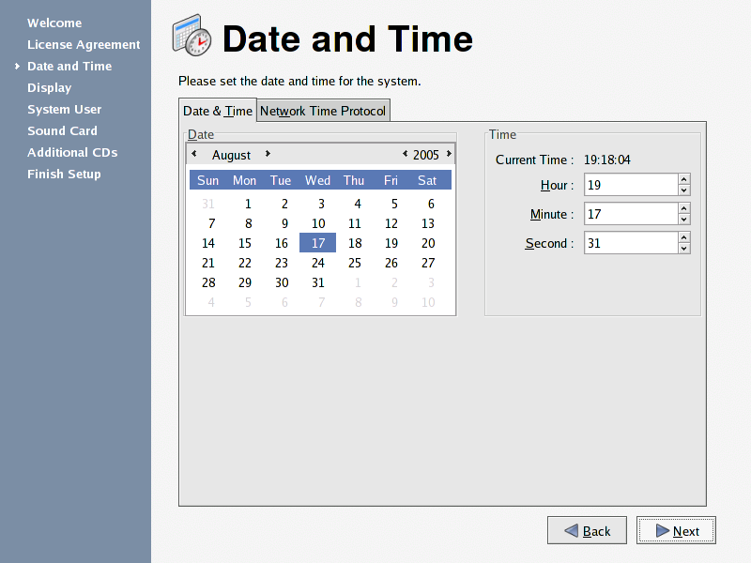

Slide 45
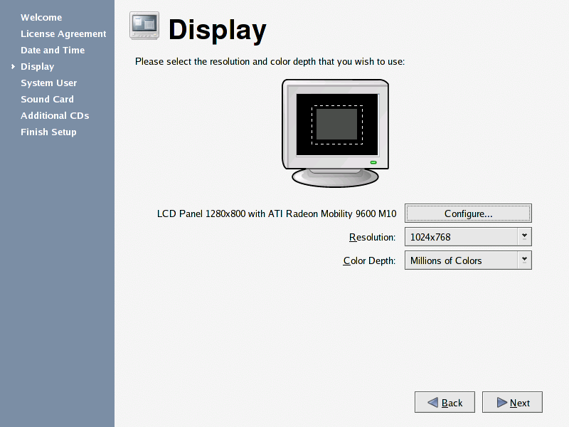

Slide 46
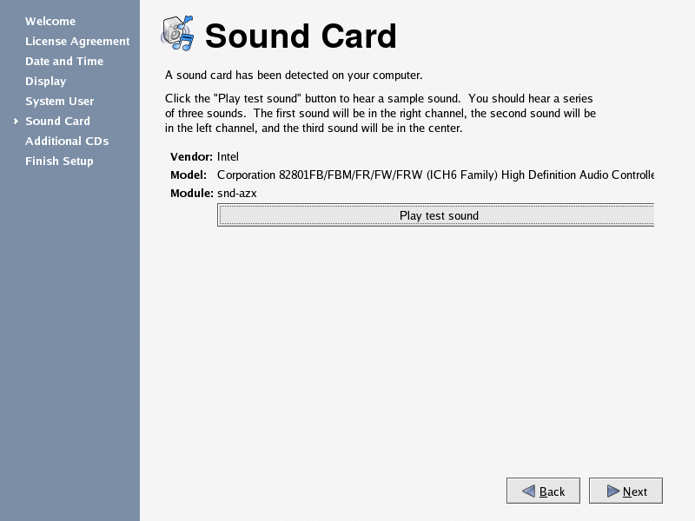

Slide 47
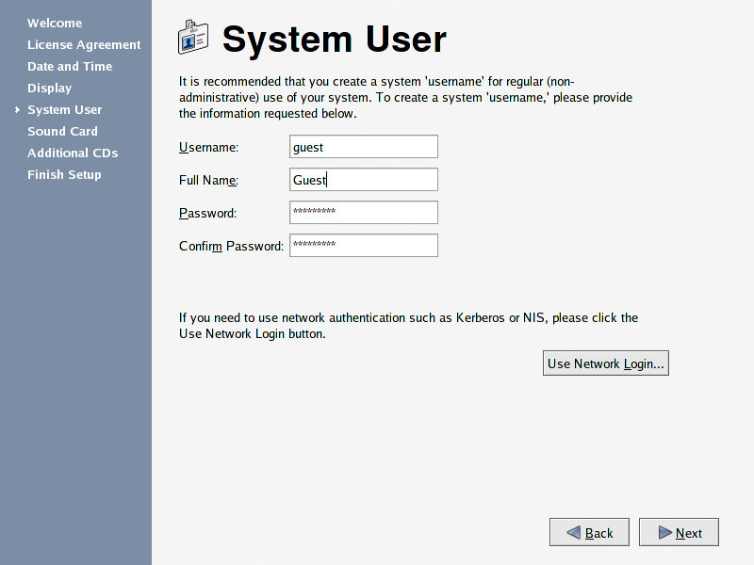

Slide 48
